Slide 1
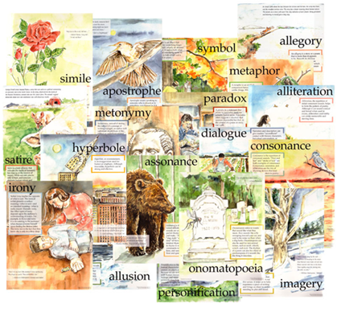
The World of Figurative Language
Standard – 7B21 Identify, explain, interpret, describe and/or analyze the examples of personification, simile, metaphor, alliteration, hyperbole and imagery in text.
Big Idea - Comprehension requires and enhances critical thinking and is constructed through the intentional interaction between reader and text.

Slide 2
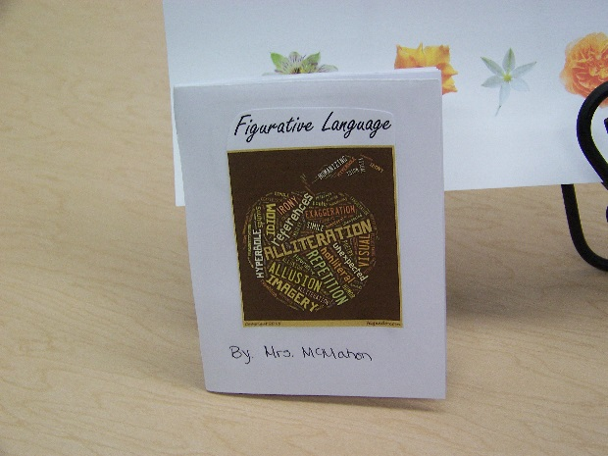
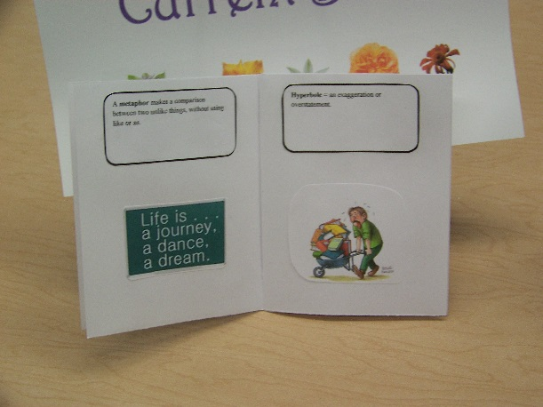
You Will Create a Book Similar to This for Your Notebook

Slide 3
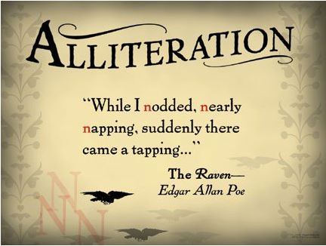
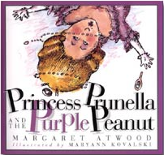
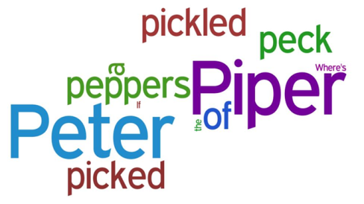
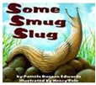
ALLITERATION
Sarah, Cynthia,
Sylvia Stout would not take the garbage out!
She’d scour the pots and scrape the pans,
Candy the yams and spice the hams…
The repetition of the beginning consonant sound in neighboring words.

Slide 4
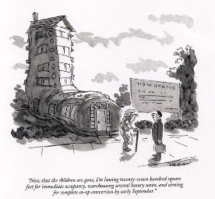
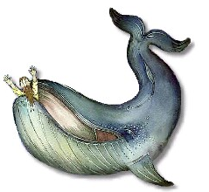
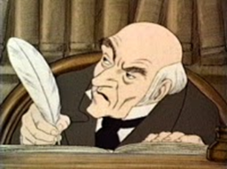
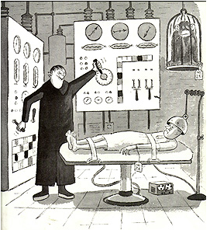
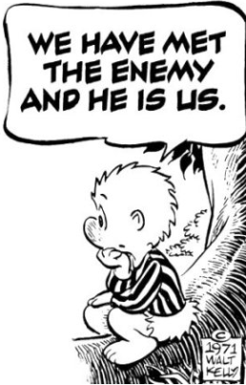
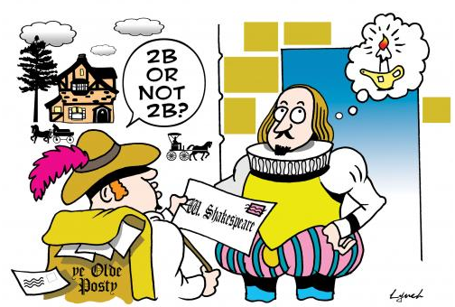
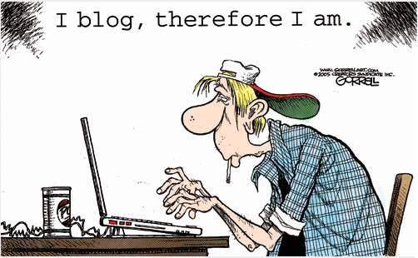
ALLUSION
As the cave’s roof collapsed, he was swallowed up in the dust like Jonah…
Christy didn’t like to spend money. She was no Scrooge, but she seldom
Purchased anything
but the bare
necessities.”
An implied or indirect reference in literature to a familiar person, place or event.

Slide 5
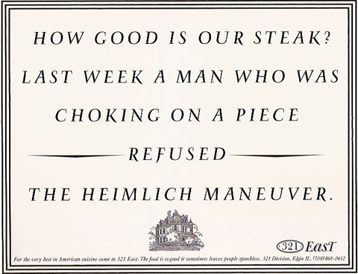
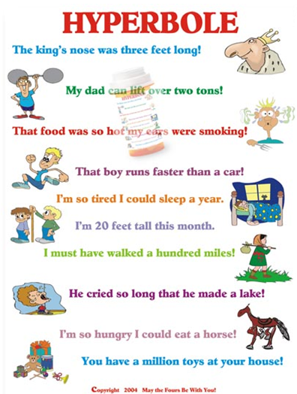
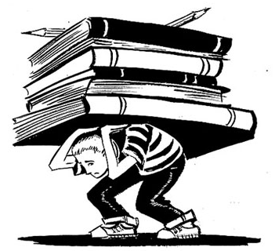
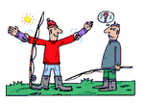
HYPERBOLE
An exaggeration or overstatement.
He’s got tons of money.
He is older than the hills.
You snore louder than a freight train.

Slide 6
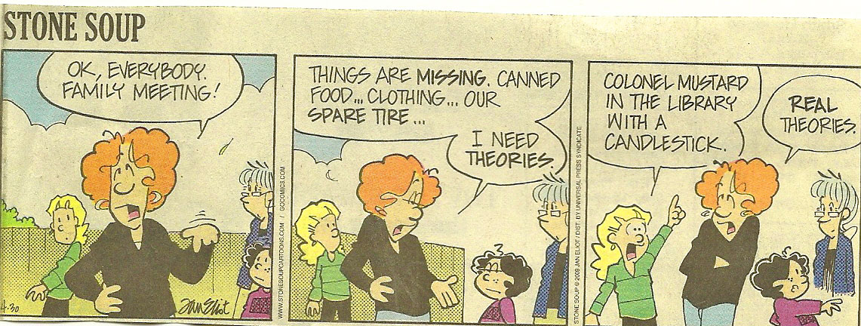
Let’s Review – Alliteration and Allusion
Allusion - The game “Clue” requires the player to make an accusation. This cartoon refers to three of the items necessary for “Clue” the person who did it, Colonel Mustard, the weapon, the candlestick and the location, the library.

Slide 7
Reviewing Alliteration, Allusion, and Hyperbole
Hyperbole - Exaggeration of what will happen if the boy has to walk to kindergarten in the cold.
Alliteration – the letter L appears at the beginning of several words in a row.
http://www.cartoonistgroup.com/store/add.php?iid=38697

Slide 8
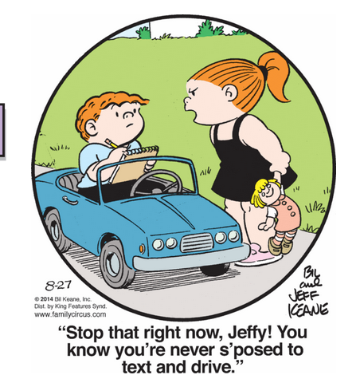
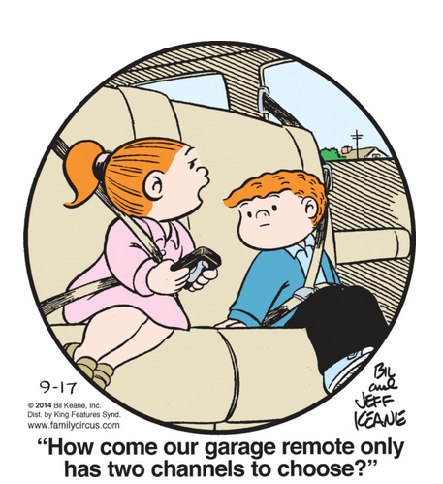
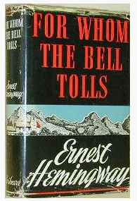
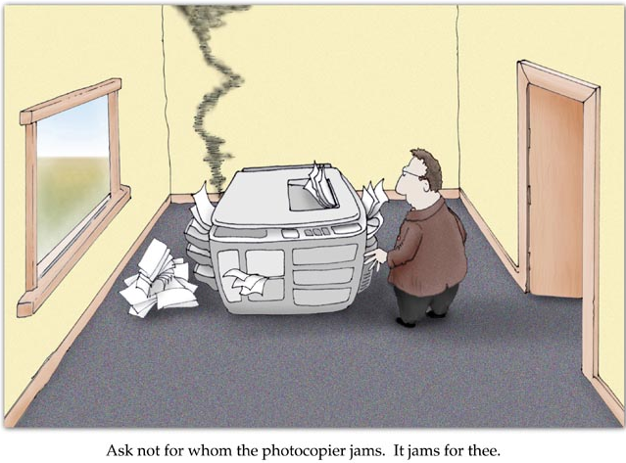
ALLUSION

Slide 9
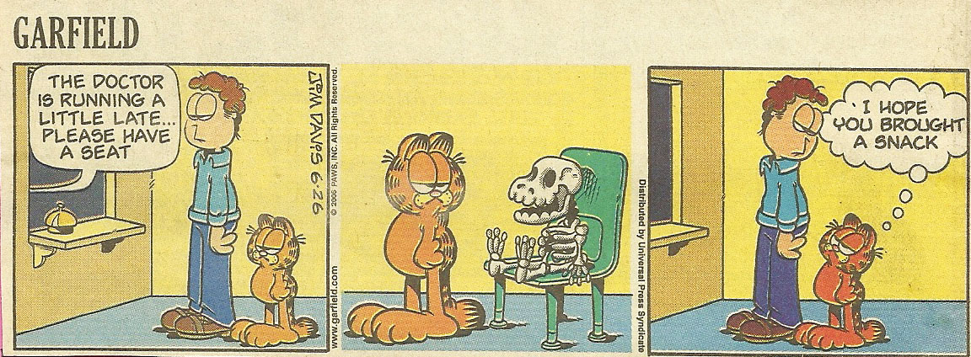
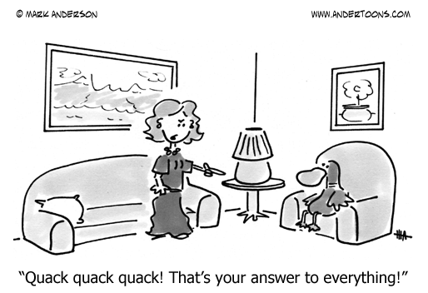
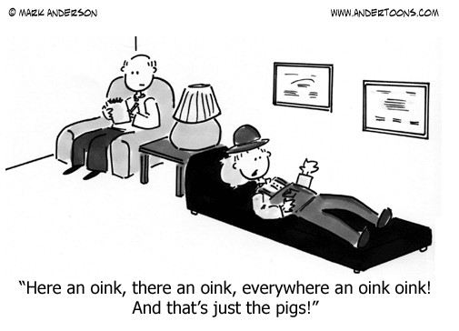
Simile, Metaphor or Hyperbole?
The wait to see the doctor is being exaggerated by the skeleton, the other patient has been waiting so long he became a skeleton.
ALLITERATION
ALLUSION

Slide 10
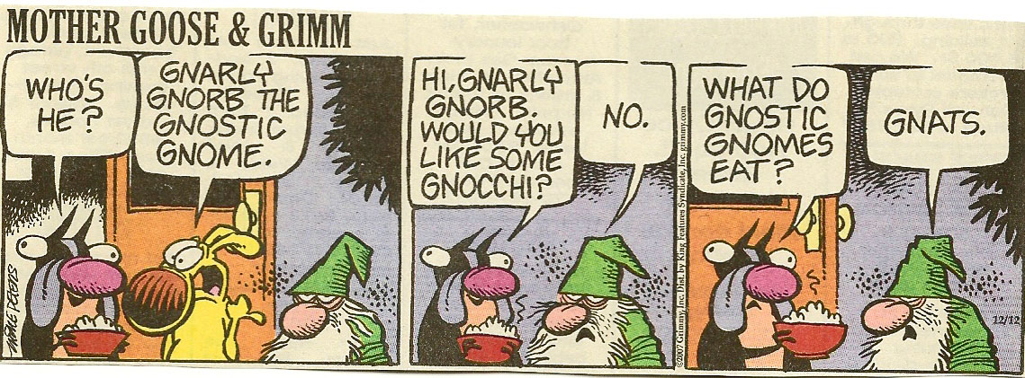
Let’s Review – Alliteration and Allusion
This comic makes reference to the Mayan calendar which predicts that the world will end in 2012 AND a reference to NFL quarterback Brett Favre who keeps coming back from retirement.
Alliteration – repetition of gn: gnarly, gnorb, gnostic, gnome.

Slide 11
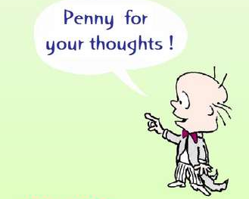
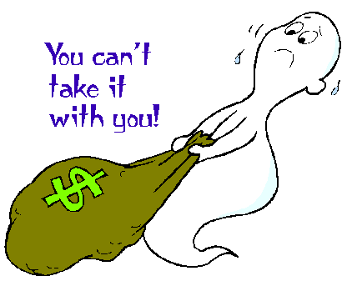
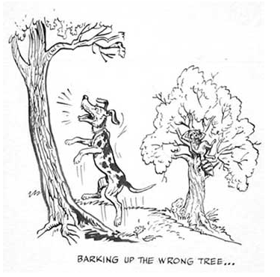
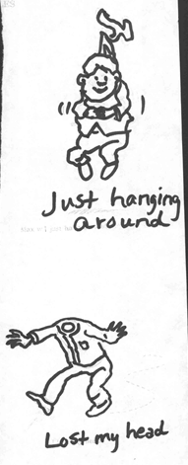
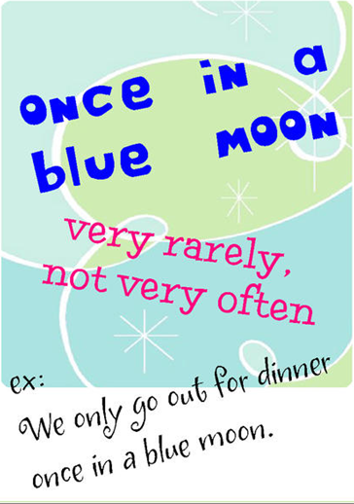
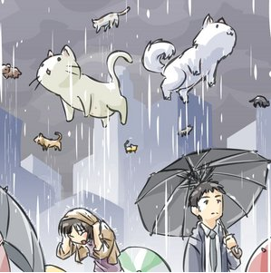
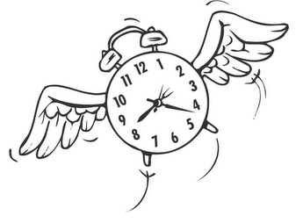
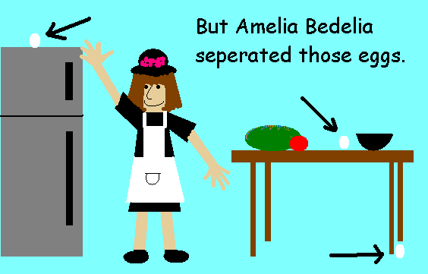
IDIOM
Come
An expression peculiar to itself grammatically or that cannot be understood if taken literally.

Slide 12
Meanings of the Idioms:
Penny for your thoughts = What are you thinking about?
Can’t take it with you = enjoy what you have now, because you can’t take it with you when you die.
Barking up the wrong tree = You have misunderstood something OR you are totally wrong.
Lost my head = lost control of his actions.
Come full circle = back to where you started.
Time flies = time moves quickly and often unnoticed.
Separated eggs = separating the egg white from the yolk.
Raining cats and dogs = Raining very hard.

Slide 13
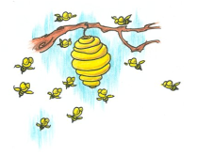
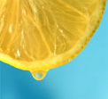
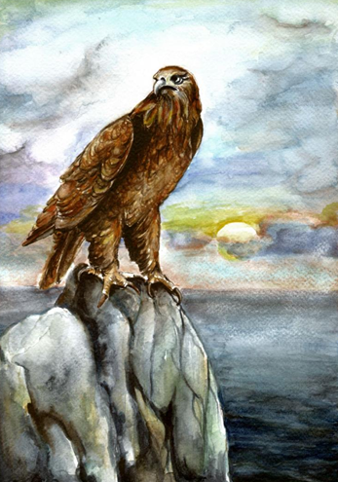
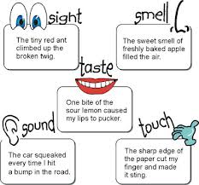
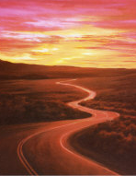
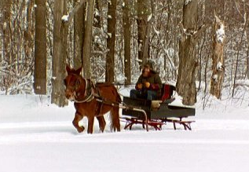
IMAGERY
I Wandered Lonely as a Cloud William Worsdworth
I wandered lonely as a cloud That floats on high o'er vales and hills, When all at once I saw a crowd, A host, of golden daffodils; Beside the lake, beneath the trees…
Summer
I like hot days, hot days
Sweat is what you got days
Bugs buzzin from cousin to cousin
Juices dripping
Running and ripping
Catch the one you love days…
- Walter Dean Myers
The Eagle
Alfred, Lord Tennyson
He clasps the crag with
crooked hands; Close to the sun in lonely
lands, Ringed with the azure world,
he stands.
The wrinkled sea beneath
him crawls; He watches from his
mountain walls, And like a thunderbolt he falls.
A word or group of words in a literary work which appeal to one or more of the senses: sight, taste, touch, hearing and smell.
Ribbon of highway.
Stopping by Woods on a Snowy Evening
Robert Frost an Exerpt
…
He gives his harness bells a shake To ask if there is some mistake. The only other sound's the sweep Of easy wind and downy flake. …

Slide 14
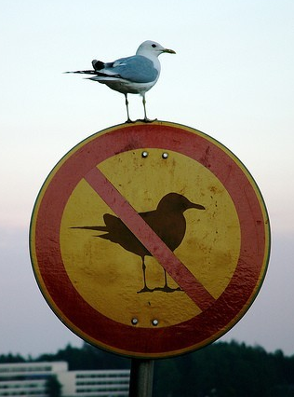
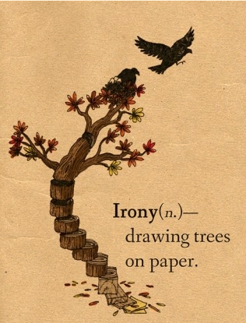
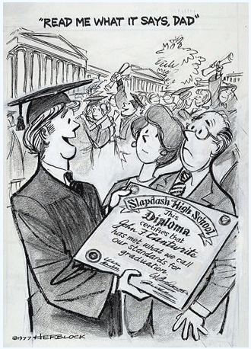
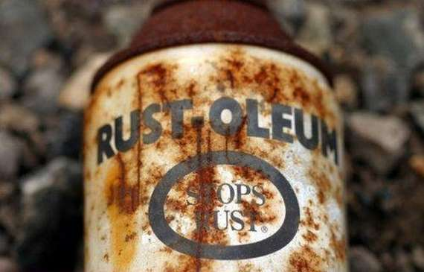
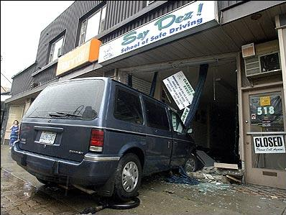
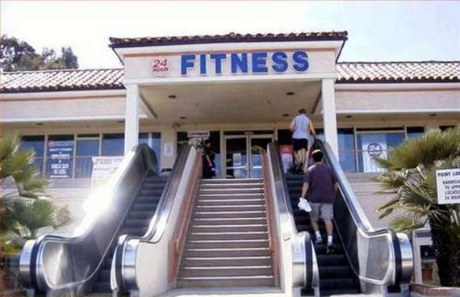
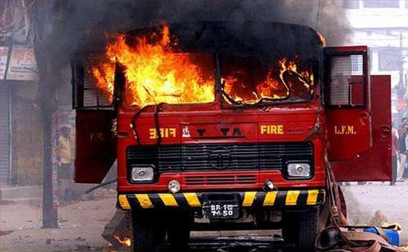
IRONY
The use of a word or phrase to mean the exact opposite of its literal or usual meaning; incongruity between the actual result of a sequence of events and the expected result.

Slide 15
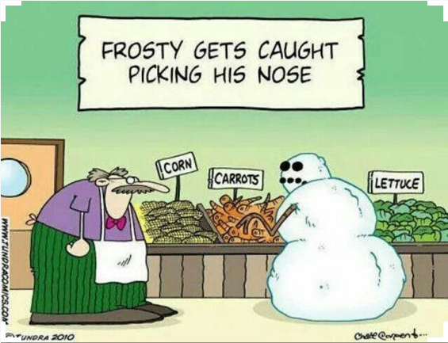
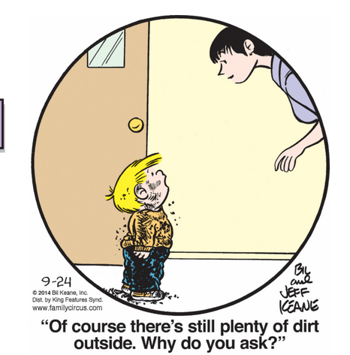
Let’s Review – Is it an example of Idiom, Irony and Imagery
Irony – Noah put pairs of animals onto the Ark, now he can’t find a pair of socks. (Also Allusion!)

Slide 16
Let’s Review Idiom, Irony and Imagery
“Though not big – nothing like Bear – I was taller than Troth. We were both thin, our bruised bodies filthy, our feet bare, our clothing mostly tattered. Troth, with her dark and staring eyes and her broken face, which she tried to hide with her long hair, often drew uneasy looks.” Crispin the End of Time p.3
Which picture best fits the imagery
Created in the passage above?

Slide 17
Checking Understanding Before Continuing On!
Irony – The man is complaining about his boss, but he is self-employed.
“I had no choice. I charged out to the edge of the stream only to sink deep into cloying, clinging mud that reached my knees. Worse, it held me. To go forward I had to yank up each leg one at a time. Every step took enormous effort and made a ghastly sucking sound. It was as if the mud were a greedy mouth, seeking to swallow me whole.”
Crispin The End of Time p. 108
$←$Imagery – the
red boxes help us imagine the scene. Yellow boxes show personification.

Slide 18
METAPHOR
Life is a bowl of cherries.
Means: Everything is going well. Life is carefree.
A figure of speech that expresses an idea through the image of another object.
He has a
heart of
stone.
(unfeeling)
Her hair
was
bone white.
Ribbon of highway.

Slide 19
ONOMATOPOEIA
The use of words whose sounds express or suggest their meaning.

Slide 20
PERSONIFICATION
An object or abstract idea given human qualities or human form.

Slide 21
SIMILE
A comparison of two unlike things in which a word of comparison, like or as, is used.

Slide 22
Let’s Review – Idiom, Onomatopoeia and Personification
The leaf “sighed,” personification.
Onomatopoeia – Bam bam bam from downstairs and the pounding on the door.
Idiom – “Watch yourself” means “be careful” not look at yourself in the mirror.

Slide 23
Let’s Review – Metaphor, Onomatopoeia, Personification and Simile
Muffin is compared to a baby using the word like, simile. PLUS, slash is onomatopoeia.
A needle in a haystack – It will be difficult to find,
it would be like looking for a little needle in
amongst all the hay.
Idiom – In the “doghouse” means that he is in trouble with someone.

Slide 24
Leaves are being compared to flowers, without the use of like or as, metaphor.

Slide 25
PERSONIFICATION
IRONY
ALLUSION

Slide 27
personification
irony
onomatopoeia
Simile
idiom
personification
hyperbole
personification
hyperbole

